Slide 1
Extragalactic Astrophysics and Cosmology Group Study 2013
Predictions Group

Slide 2
Our Aim:
To be able to predict the number of high redshift galaxies one would detect within a given absolute magnitude range for a given filter band.

Slide 3


How we intend to do this:
Find a general Schechter Function.
Mathematical process to convert Schechter Function into observing units.
Build program to automate process. IN PROCESS
Find plausible starting parameters.
Collate parameter data from papers. IN PROCESS
Determine parameter evolution with time. IN PROCESS
Plot results/ data visualisation.
Give to observers.
Refine technique- include more sophisticated adaptations.

Slide 4

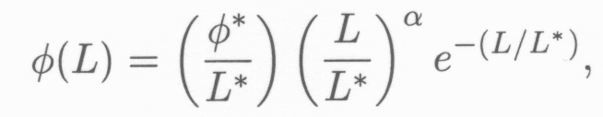

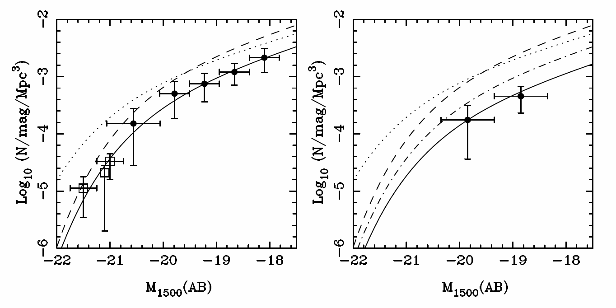
Schechter Function
Z=7
Z=8
(McLure, 2010)

Slide 5

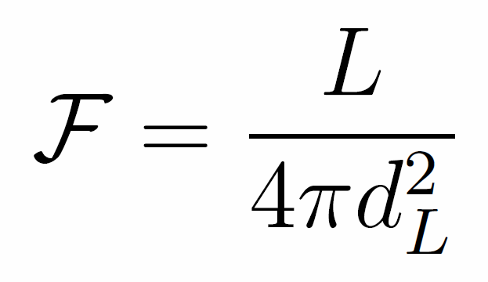
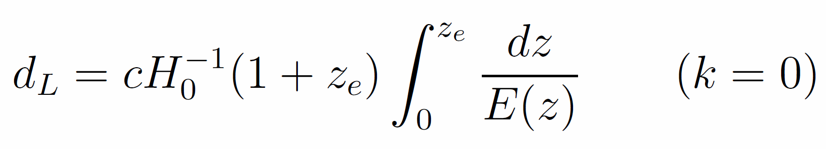
Co-moving Distance
Luminosity Distance
Magnitude Conversion
Notes:
dH (hubble distance) radius of the visible universe. Luminosity distance is redshifted. Magnitude conversion is for AB system.

Slide 6
Parameters and Assumptions
JOSH

Slide 7
Programs A. And B.
We have two programs computing the same quantities in slightly different ways in order to validate any results we obtain.
Owen and Andy

Slide 8
How we could refine this
Can refine code by accounting for cosmic variance and including
gravitational lensing, where applicable.
Cosmic Variance
The Universe is only homegeneous at the largest scale (>1Gpc).
Measurements are affected by the large-scale cosmic structure.
In general, the dominant source of error, well in excess of Poisson noise, comes from Cosmic Variance.
Gravitational Lensing (as per Catherine’s slides)
Galaxies at extreme redshifts are too faint to detect.
Their apparent magnitude can be amplified by a factor of ten by using nearby superclusters as Gravitational lenses.
This allows us to probe further back towards the beginning of reionization.

Slide 9
Allowing for Cosmic Variance
Any number or density measurement derived from a galaxy population is susceptible to Cosmic Variance.
Therefore, any estimates produced for the observing team from the code, should account for this in some way.
The Cosmic Variance of a survey is empirically reduced with multiple sightlines, by √N – where N is the no. of sightlines.
It is also lower for higher aspect ratio surveys.
The bulk of the refining process will be using this information to best advise the
observing team on how to proceed with their survey, to obtain a fair sampling of
galaxies i.e. one that is likely to representative of the galaxy distribution as a whole, at
that cosmic time.

Slide 10
Plans for the future:
Get both programs working.
Continue trying to gather relationship of parameters with time.
Research into cosmic variance; how are we going to include it in our calculations? What formulae might we need?
Produce refined programs.
Meanwhile all continually working on our own individual contributions to the report which were designated last Tuesday.

